Slide 1

BABYAI AND RESTRAINING BOLTS
Reasoning Agents – Prof. De Giacomo

Slide 2



Who we are
github.com/francesco-AI/ReasoningAgent2020
FRANCESCO CASSINI
785771
BOTA DUISENBAY
1849680
DAVIDE GIORDANO
1852364
FRANCESCO VINCELLI
1727959

Slide 3
Index
1
02
03
04
2
3
4
Presentation
of BabyAI paper
NLP to LDLf
Imitation Learning
theory
Implementation

Slide 4
1. Presentation of BabyAI paper
An introduction to the paper from which we took inspiration

Slide 5
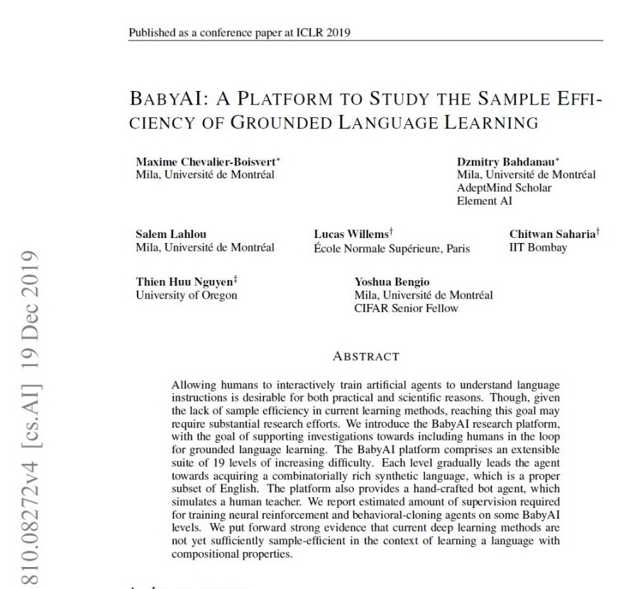
Introduction
BabyAI is a paper written in 2019 that aims to teach a bot to acquire a combinatorially rich synthetic language;
BabyAI is also a research platform towards including humans in the loop for grounded language learning.

Slide 6
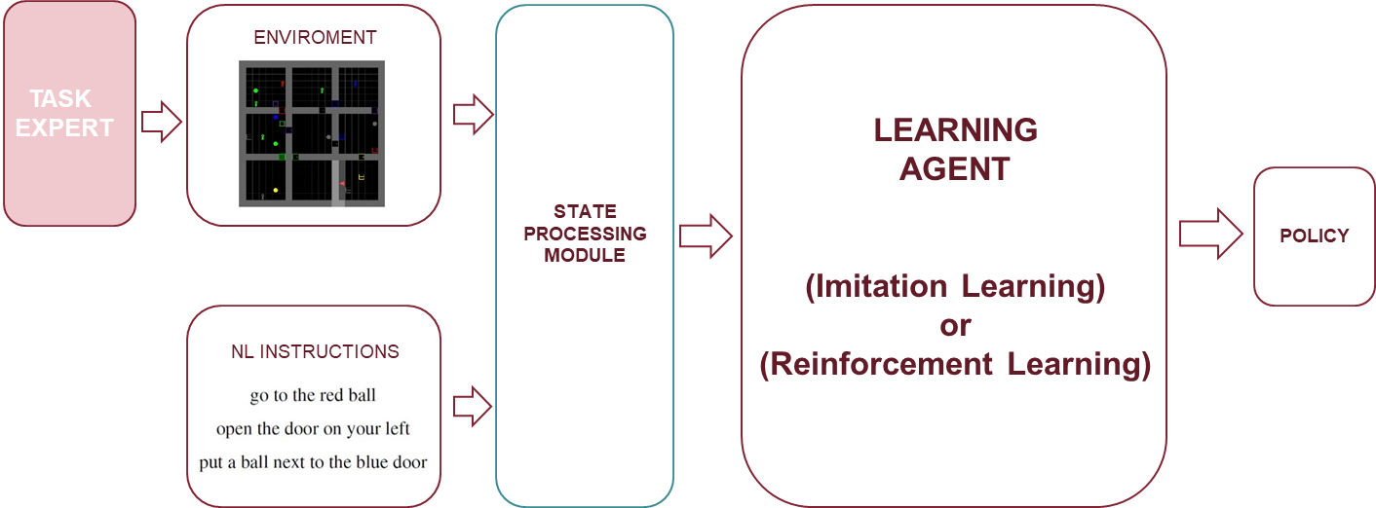
BabyAI – Previous works
To understand BabyAI network we have to cite some previous research in the field of grounded language learning.
“Gated-Attention Architectures for Task-Oriented Language Grounding”
[2018: Chaplot, Sathyendra
et others]

Slide 7
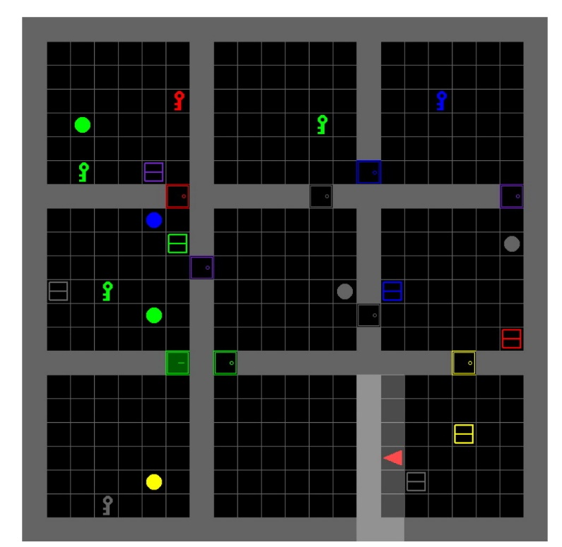
BabyAI – Platform Description
The elements that characterize BabyAI platform.
Minigrid
The MiniGrid environment is fast and this makes experimentation quicker and more accessible.

Slide 8
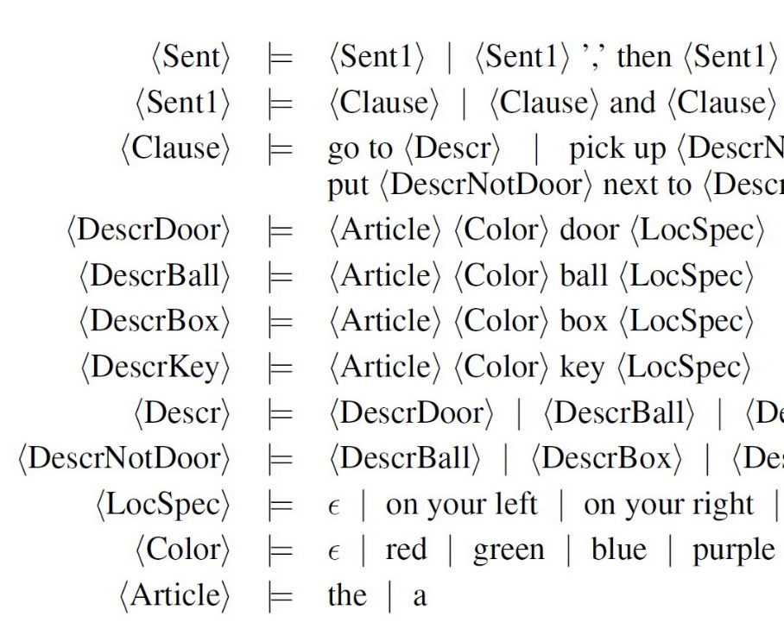
BabyAI – Platform Description
The elements that characterize BabyAI platform.
Baby Language
The instructions are in a simplified subset of English and it's possible combine more instructions together.

Slide 9
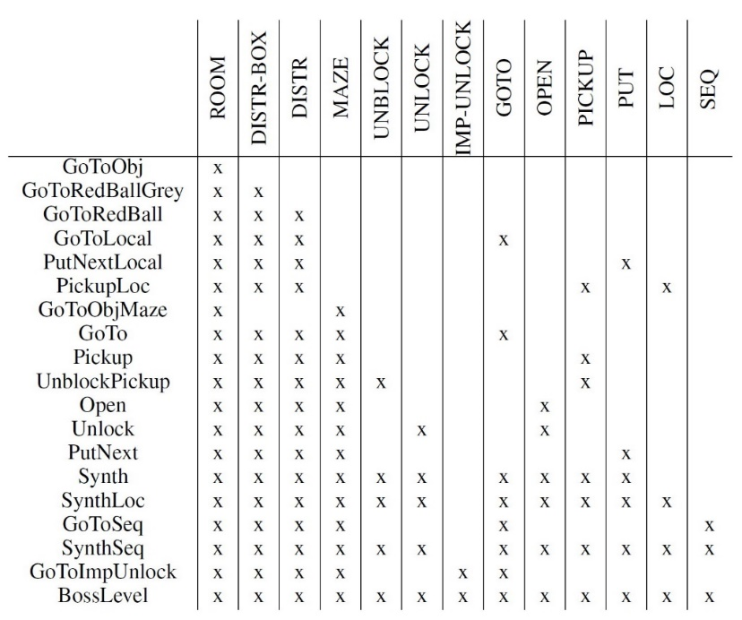
BabyAI – Platform Description
The elements that characterize BabyAI platform.
Levels and Curriculum learning
To investigate on curriculum learning, the environment is composed by 19 levels in which the difficulty are gradually increased.

Slide 10
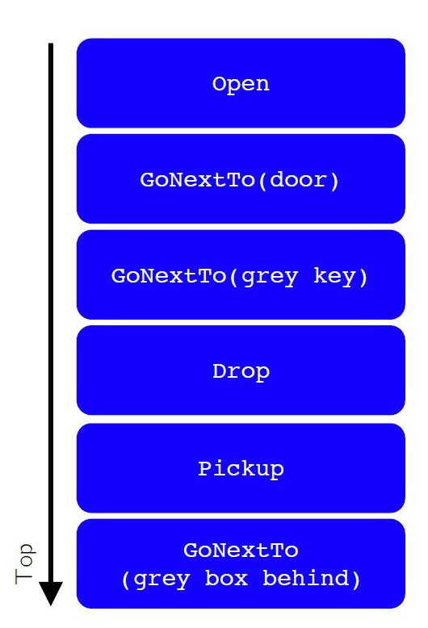
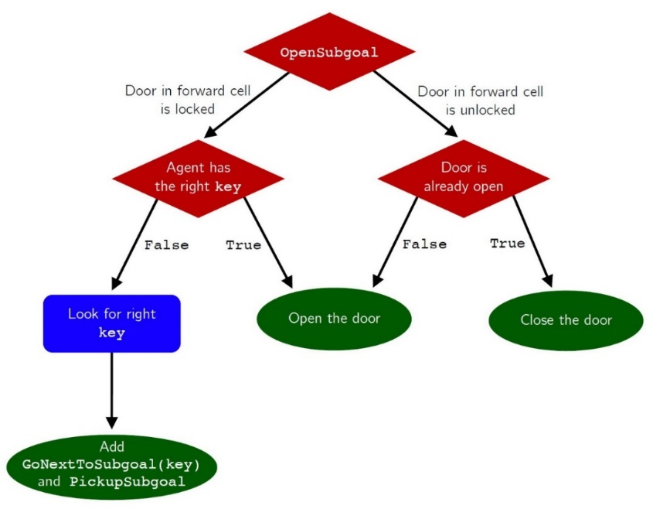
BabyAI – Platform Description
The elements that characterize BabyAI platform.
The Bot
The Bot plays the role of the human in the loop.

Slide 11
2. NLP to LDLf

Slide 12
Why ?
Mapping from free unbound natural language to its machine understandable representation is required:
Formalization to avoid ambiguity
Natural to untrained domain experts:
Wider application
No more training requirement
“After the button is pressed, the light will turn red until the elevator arrives at the floor and the doors open.”
p → X ( q U ( s ∧ v ) )
p - button being pressed
q - the light turning red
s - the elevator arriving
v- the doors opening

Slide 13
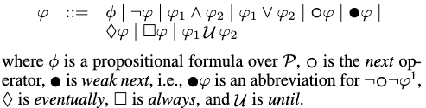
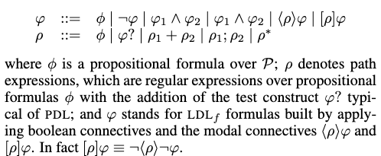
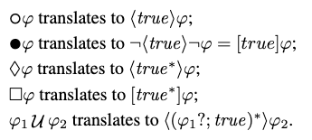
What? LTLf vs LDLf
Linear Dynamic Logic on finite traces (LDLf) - more expressive extension of LTLf, that results from addition of Propositional Dynamic Logic syntax

Slide 14
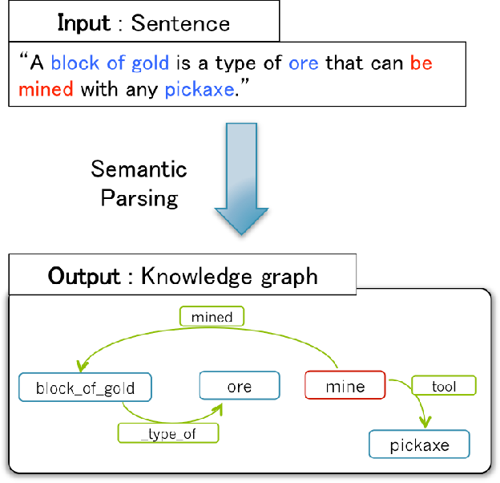
Approaches:
Semantic parsing
Common pattern of syntactic structure for controlled English
Translation problem
Optimization problem
Event identification and ordering

Slide 15
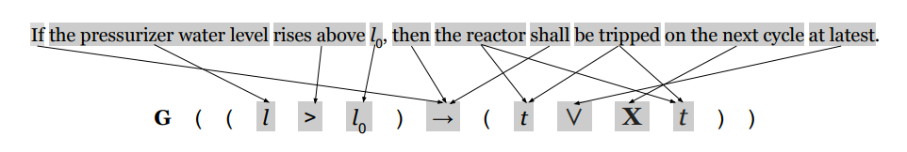
Approaches:
Semantic parsing
Translation problem
Logic is treated as a language and train NN/CNN for statistical models
Optimization problem
Event identification and ordering

Slide 16
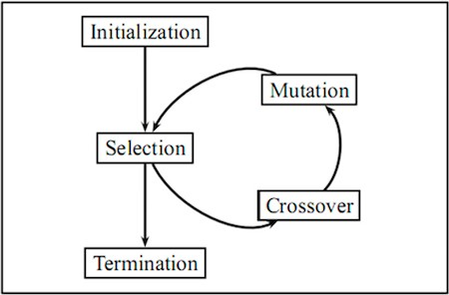
Approaches:
Semantic parsing
Translation problem
Optimization problem
Evolutionary Computation for determining best matching temporal formula
Event identification and ordering

Slide 17
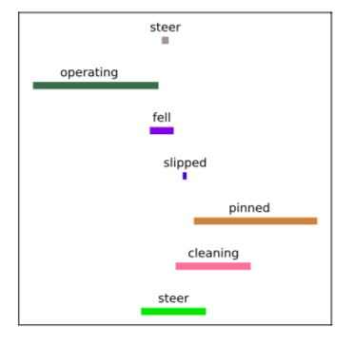
Approaches:
Semantic parsing
Translation problem
Optimization problem
Event identification and ordering
Identify temporal characteristics and encode temporal order between events with graph

Slide 18
Approaches:
Semantic parsing
Translation problem
Optimization problem
Event identification and ordering

Slide 19
General scheme: Syntactic analysis
POS TAGGING:
NN VB DT NN CJ VB DT NN PP VB DT NN
Agent | (N1, o) | N1->Noun
picks | (V1, o) | V1->Tv
a ball | (N2,o) | N2->Det N2
picks a ball | (Rc1,o) | Rc1->N1 V3 N4
takes | (V2, o) | V2->Tv
the key | (N3,o) | N3->Det N3
unlock | (V3, o) | V3->Tv
the box | (N4,o) | N4->Det N4
unlock the box | (Rc2,o) | Rc2->N1 V3 N4
takes the key to unlock the box | (Rc2,o) | Rc2->N1 V2 N3 Rc2
final sentence | (Rc3,o) | Rc3->Rc1 Rc2
Agent picks a ball and takes the key to unlock the box
DEPENDENCY PARSING
Agent
SUBJ
DEP
DEP
picks a ball
takes the key
XCOMP
to unlock the box
SEMANTIC ROLE LABELING
picks
unlock
Agent
a ball
Agent
the box
takes
Agent
the key
to unlock the box

Slide 20
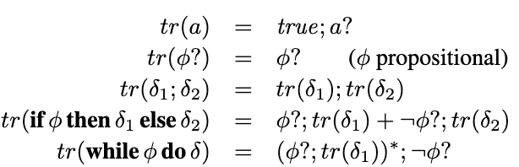
General scheme:
grammar-based parser
Agent | (N1, o) | N1->Noun
picks | (V1, o) | V1->Tv
a ball | (N2,o) | N2->Det N2
picks a ball | (Rc1,o) | Rc1->N1 V3 N4
takes | (V2, o) | V2->Tv
the key | (N3,o) | N3->Det N3
unlock | (V3, o) | V3->Tv
the box | (N4,o) | N4->Det N4
unlock the box | (Rc2,o) | Rc2->N1 V3 N4
takes the key to unlock the box | (Rc2,o) | Rc2->N1 V2 N3 Rc2
final sentence | (Rc3,o) | Rc3->Rc1 Rc2
<
(!ball&!key&!box)*;ball;
(!ball&!key&!box)*;key;
(!ball&!key&!box)*;box; > tt

Slide 21
3. Imitation Learning

Slide 22
Understanding the problem
Generate DFA for the expert agent
Temporal logic definition of agent Task
Reactive Synthesis
LDLf to DFA translation
Use Restraining Bolt to train the expert agent on Q
Restraining Bolt
Fluent traces generation
Train LEarner Agent on Expert Policy
Imitation Learning (Inverse Reinforcement Learning)
Learner DFA Exraction

Slide 23
Generate DFA from LDLf formulas
Task definition
In synthesis typically agent tasks are expressed in terms of traces in temporal logic (LDLf in our case)
A trace τ is a finite (LDLf) sequence of fluents ∪ actions evaluations.
Example:
Task: “unlock the door and get the box”
<(¬ key ⋀ ¬ door ⋀ ¬ box )* ; key ; <(¬ key ⋀ ¬ door ⋀ ¬ box )* ; door ; <(¬ key ⋀ ¬ door ⋀ ¬ box )* ; box >tt
𝝋* (safety) : means that always, until the end of trace, 𝝋 holds.
In example, 𝝋 = (¬ key ⋀ ¬ door ⋀ ¬ box )
true*; 𝝋_𝟏 ; true* ; 𝝋_𝟐 ; true* ; 𝝋_𝟑 (ordered occurrence): says that 𝝋_𝟏 and 𝝋_𝟐 and 𝝋_𝟑 will happen in order.
In example: 𝝋_𝟏 = key | 𝝋_𝟐 = door | 𝝋_𝟑 = box
⟨ρ⟩𝝋 : all ‘’executions’’ of RE ρ (along the race) end with 𝝋 holding.
In example: 𝝋 = tt (true) | ⟨ρ⟩ = <(¬ key ⋀ ¬ door ⋀ ¬ box )* ; key ; <(¬ key ⋀ ¬ door ⋀ ¬ box )* ; door ; <(¬ key ⋀ ¬ door ⋀ ¬ box )* ; box >

Slide 24
Generate DFA from LDLf formulas
Synthesis
Given an LDLf task ‘Task’ for the agent:
Find agent behavior σ_a such that ∀σ_e, trace (σ_a , σ_e)|= Task
Agent Behavior
Also called “strategy”, “policy”, “protocol”, “process”: σ_a : (fluents)* → actions
where:
(fluents)* denotes the history of what observed so far by the
agent (a finite sequence of fluents configurations)
actions denotes the next action that the agent does

Slide 25
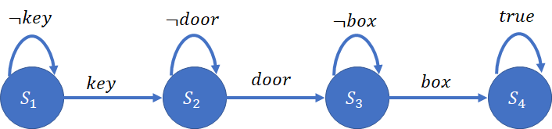
Generate DFA from LDLf formulas
LDLf to DFA translation
LTLf /LDLf formulas can be translated into deterministic finite state automata (DFA)
t |= 𝝋 iff t ∈ 𝓛(𝐴_𝝋) , where:
t is the trace of fluents;
𝐴_𝝋 is DFA 𝝋 is translated into ;
𝝋 is the LDLf formula
DFA generated from LDLf formulas

Slide 26

Using RB to train expert agent on DFA
Restraining Bolt
A Restraining Bolt (RB) is a tuple where each phi_i is an LDLf \ LTLf formula over a set of fluents L and each r_i is a reward value.
Fluents constitute the RB’s representation of the environment state and need not match the RL agent features (and typically they do not). Formulas phi_i specify the behaviors that should be rewarded, each with its respective r_i. As known (De Giacomo and Vardi 2013) LDLf / LTLf formulas can be equivalently represented as DFAs, and this representation is used to constrain an agent’s behavior to fulfill high-level (i.e., fluent-based) goals.

Slide 27
Using RB to train expert agent on DFA
Thus the task is represented by the DFA Q corresponding to a formula phi_i. As a result, we consider RBs of the form <L, Q, r_i> where Q is a DFA representing an LTLf/LDLf formula and r is a reward value associated with the accepting states of Q.
Consider now an expert agent defined on an MDP Me = <Se; Ae; T re; Re >. The agent can execute optimal policies of a given target task represented by a DFA Q, but cannot make the corresponding reward function explicit; in other words, the agent knows how to accomplish the task but cannot describe it.
As the agent executes the policy, some traces are produced, some of which are desirable (posiive) and some other are not. The expert can correctly classify the traces as positive or negative, based on its own state representation.

Slide 28
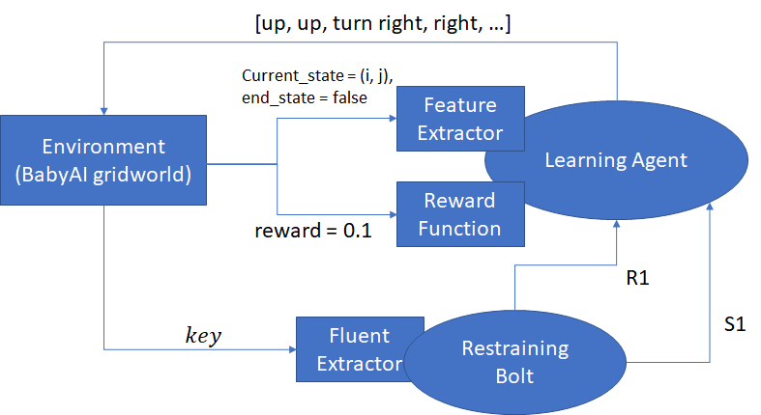
Using RB to train expert agent on DFA

Slide 29
Train learner agent on expert policy
Imitation Learning
In our project we focused on Inverse Reinforcement Learning (IRL) approach for the implementation of the IL algorithm, as discussed in the paper “Imitation Learning over Heterogeneous Agents with Restraining Bolts” (De GIacomo, Favorito, Iocchi, Patrizi) .
The main idea of IRL is to learn the reward function of the environment based on the expert’s demonstrations, and then find the optimal policy (the one that maximizes this reward function) using reinforcement learning
Thus the RB device is attached to the learner agent to drive the learning process and ultimately make it imitate the expert.

Slide 30


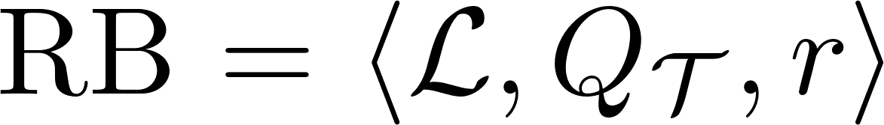

Train learner agent on expert policy
Learner DFA Extraction
Let be a set of fluent traces collected while observing the behavior of the expert.
The imitation learning process consists in recostructing a DFA that is consistent
with , i.e., that accepts all of its positive traces and none of its negative. Thus is a new RB:
The generated RB can be placed on the learner agent to drive the learning process of a behaviour imitating the expert’s.
RB’s DFA learning setting

Slide 31
Train learner agent on expert policy
Consider a learner agent defined on Ml = <S_l , A_l , Tr_l , R_l >, with Tr_l and R_l unknown, equipped with the RB that encodes the behavior of the expert agent in performing the given task. The system M_l^RB = < Ml , RB > can be used to learn an optimal policy driven by RB, as explained in (De Giacomo et al. 2019). In this way, the behavior of the learner agent imitates that of the expert, when considering the evolution at the RB level.

Slide 32
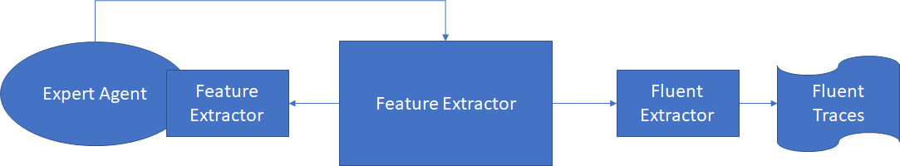
Train learner agent on expert policy

Slide 33
4. Implementation

Slide 34
Summary
NLP
Environment
Learning
Demo

Slide 35



Natural Language Processing
SPEAKING
Acquire sentence by listening to the speaker
TRANSCRIBING
Transcribe what the speaker has said
POS TAGGING
TRANSLATING
Translate the NL sentence into LDLf
Apply Part Of Speech tagging to the sentence in order to be able to create links between verbs and objects
LDLf

Slide 36
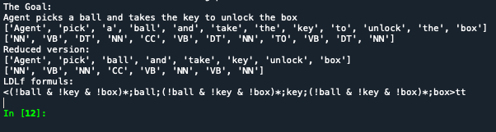
NLP to LDLf

Slide 37

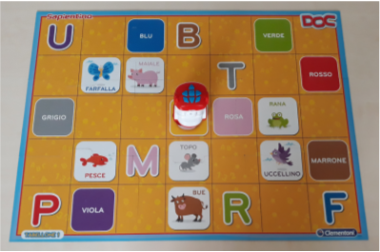

Environment
In order to replicate as much as possible the environment of BabyAI, we focused on the actions that our agent would implement.
Requests: Get the box
Open the door
Move the ball
Use the key
...

Slide 38






Actions and objects
In its basic version, Minecraft defines two main actions: get and use. A third action to manage pick and drop situations is added to these two.
GET
USE
MOVE
All the objects provided by Minecraft, were replaced by typical objects of BabyAI. Another category of objects is also added.
Resources: DOOR
BOX
BALL
BASE
Tools: KEY
Obstacles: WALL

Slide 39
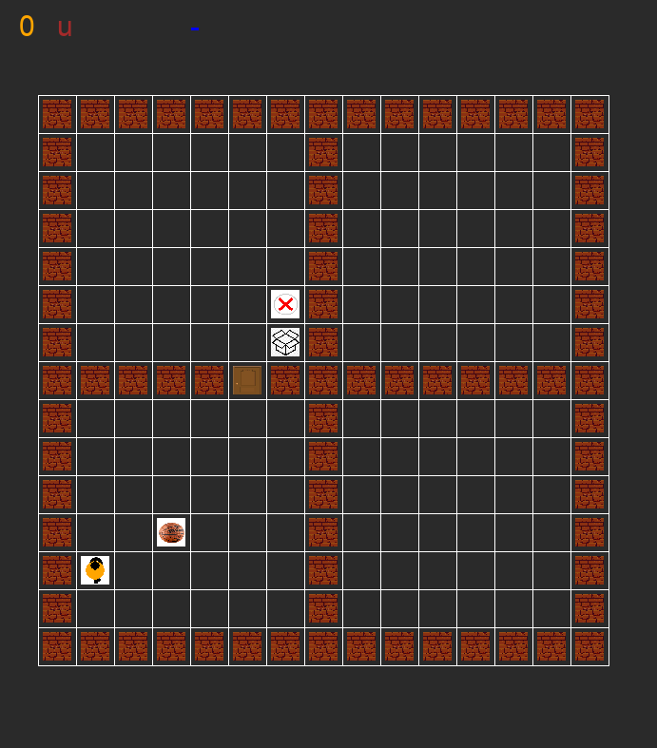
Learning
Use the key, open the door and get the box.
Positive Traces
key; door; box
key; door; box
key; door; box
key; door; box
...
Negative Traces
key; key
door
key; box
key; key
...
Expert Params Learner
30000 num_steps 100000
0.1 min_eps 0.1
0.99 gamma 0.99
0.1 alpha 0.1
sarsa algorithm sarsa

Slide 40
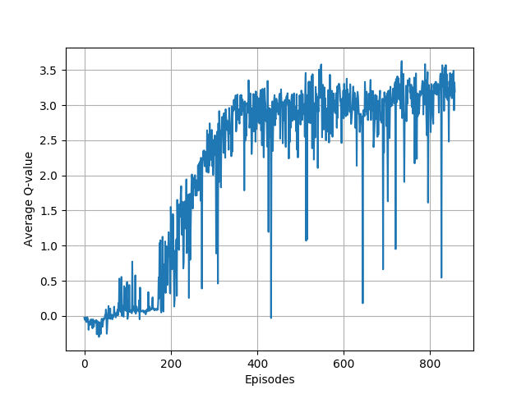
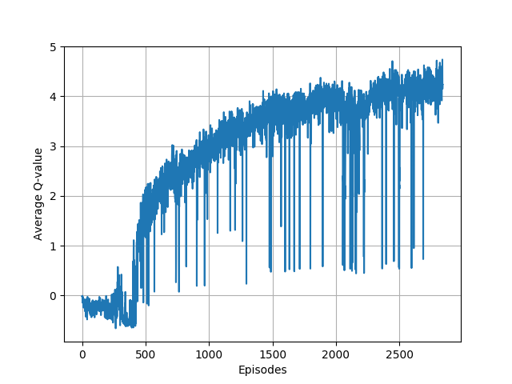
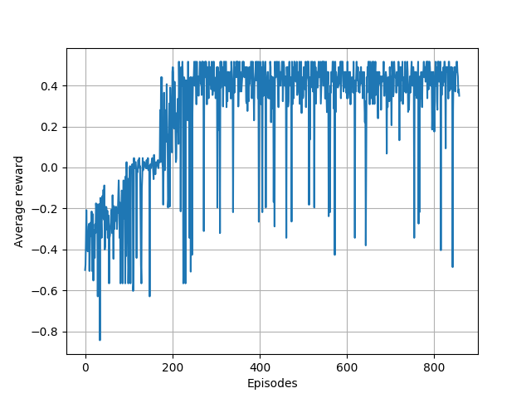
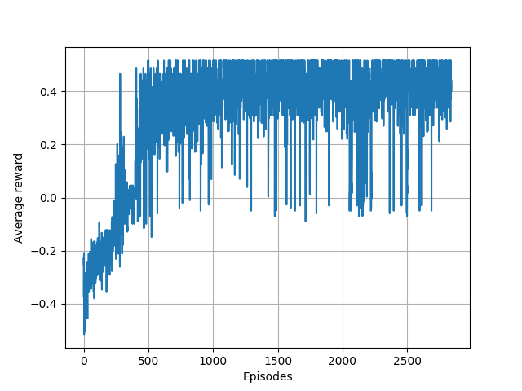
Learning

Slide 41
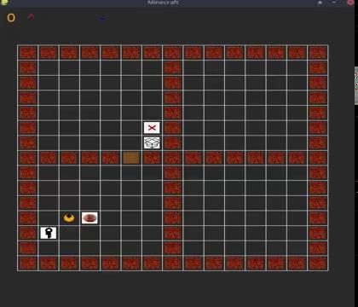
Demo - Level 1
Task: Use the key and get the box
The agent must unlock the door before accessing the second room where the box is placed. Once it uses the key, the door gets unlocked and it is no more an obstacle.

Slide 42
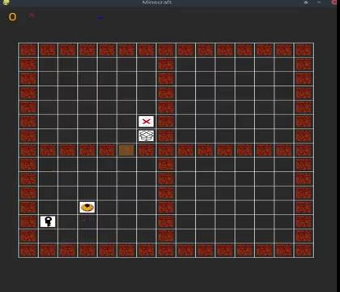
Demo - Level 2
Task: Use the key and move the ball
The agent must unlock the door before accessing the second room where the base is placed. Once it uses the key, the door gets unlocked and it is no more an obstacle. The ball is also moved from the initial position to the base.

Slide 43

Conclusions
BabyAI-like environment implementation
LDLf and Restraining Bolt integration
Combination of multiple tasks
Future works: Usage of BabyAI to make the agent understand LDLf

Slide 44
References
BABYAI: A Platform to study the sample efficiency of grounded language learning
[Chevalier-Boisvert, Bahdanau, et al. - 2019]
Gated-Attention Architectures for Task-Oriented Language Grounding
[Chaplot, Sathyendra - 2018]
Synthesis of LTL formulas from natural language texts: State of the art and research directions
[Andrea Brunello, Angelo Montanari, Mark Reynolds - 2019]
Imitation Learning over Heterogeneous Agents with Restraining Bolts
[De Giacomo, Marco Favorito, Luca Iocchi, Fabio Patrizi - 2020]

Slide 45
Thank you!

